Slide 1
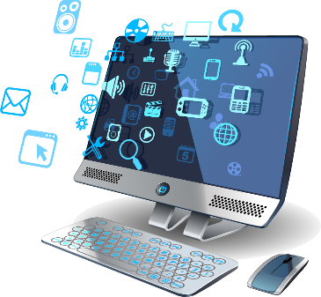
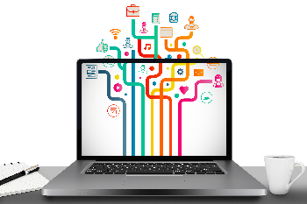
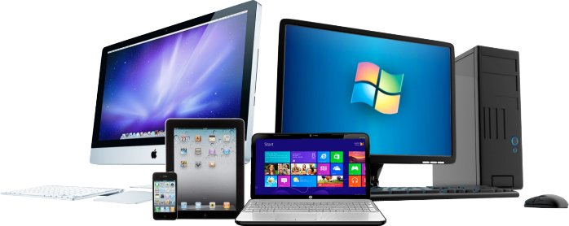
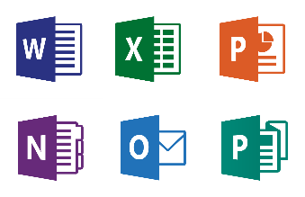
Computer Hardware
And Software

Slide 2
Objectives
Explain the parts of a computer system
Describe the different hardware components and the functions of each.
Define software and list various types of software.

Slide 3
A Computer System
A computer system consists of different units. These units have their own functions. They are connected with each other via cables or other medium. These units are connected with a purpose of smooth operation of the computer.
A computer system has four major functions:
Input Unit,
Processing Unit,
Output Unit
Storage Unit.

Slide 4
Input Unit
The task of the Input Unit is very simple – to input data into the computer. All the devices that somehow enter data into the computer are input devices. We type into a keyboard to enter data, click on mouse to issue commands, scan images, record voices, and shoot videos. All are examples of input.
The two most commonly used input devices are a keyboard and a mouse.

Slide 5
Processing Unit
The task of processing unit is to process data. It obtains data from the input unit, performs the necessary calculations, and comparisons to produce the result. This unit is often called the central processing unit (CPU). It is known as the “brains” of the computer.

Slide 6
Output Unit
This unit provides results to the user in a suitable form. A computer may display on the monitor, produce sound from a speaker, or a printout through the printer.
A printer produces a hard copy of output.
The monitor produces a soft copy of output.

Slide 7
Storage Unit
The storage unit facilitates the data storage in computer so that it can be kept safe for future use.

Slide 8
View of a Personal Computer System

Slide 9
Software
Software is a set of instructions that tells the computer what to do.
Software can be split into two main types:
system software
application software

Slide 10
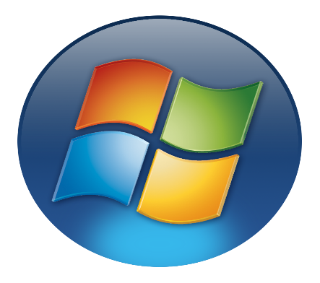
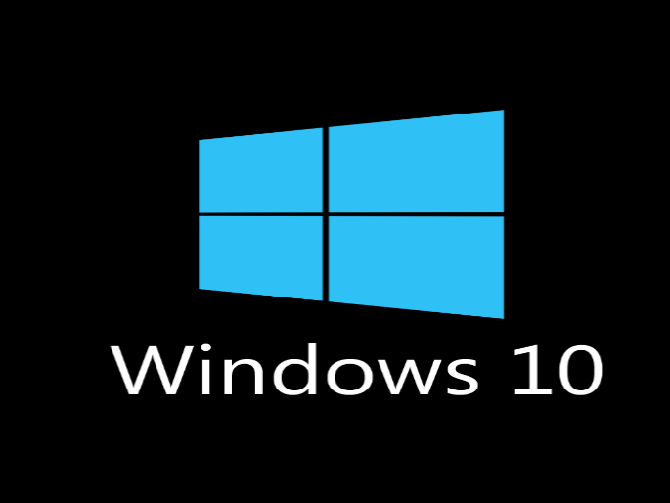
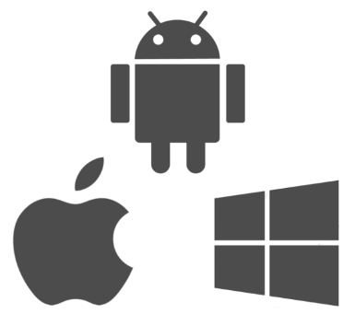
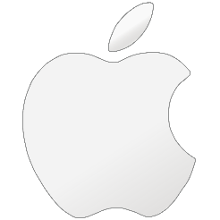
System Software
System software is a program that manages and supports the computer resources and operations of a computer system while it executes various tasks such as processing data and information, controlling hardware components, and allowing users to use application software.

Slide 11
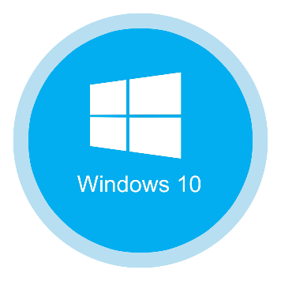
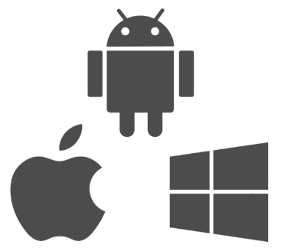
Examples of System Software
Operating Systems are the main examples for system software.
Examples of OS are as follows:
Microsoft Windows
Mac OS X
DOS

Slide 12
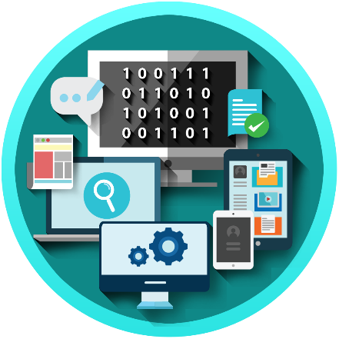
Application Software
Application software consists of programs that direct computers to perform specific information processing activities for end users.

Slide 13
Types of Application Software
Word Processing Software (Word)
Spreadsheet Software (Excel)
Database Software (Access)
Presentation Software (PowerPoint)
Educational Software (Edutype)
Entertainment Software (Games)

